Slide 1
The crucible a drama by Arthur miller

Slide 2
Elements of a drama
Acts and scenes
There are USUALLY 4 acts in a play
Each act has multiple scenes within it
Dialogue
Conversation among people
In a play there will be no quotation marks. Mostly everything is dialogue so it’ll just have the character’s name and then their line
Stage direction
Anything that is in italics is the stage direction and will be read by the narrator

Slide 3
Elements of a drama cntd.
The plot structure
Exposition
Introduces the characters and plot
Rising action
This is where the majority of the story takes place. Here the major conflict is introduced and unfolds. The characters develop throughout the rising action.
Climax
The turning point
Falling action
Resolution/Denouement
The conclusion
Everything at this point should be settled (characters, conflict, etc.)

Slide 4
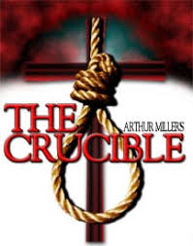
Types of drama
Two main kinds
Comedy
Has a happy ending
Tragedy
Shows the downfall of the protagonist (main character) due to a tragic flaw
Side note- The Crucible may SEEM comedic because of how insane the girls are, but it is a tragedy!

Slide 5
Sub-Types of drama
Historical – based on events of the past (The Crucible)
Melodrama – stereotyped characters & exaggerated conflicts
Tragicomedy – combines tragic & comic elements (think: dark humor)
Modern Realism – ordinary language, realistic characters, & controversial issues
Political – reflects an opinion on a political theme or issue (The Crucible)

Slide 6
Dramatic terminology
Soliloquy
Character gives a speech alone on stage
Monologue
Character gives a speech with other characters on stage

Slide 7
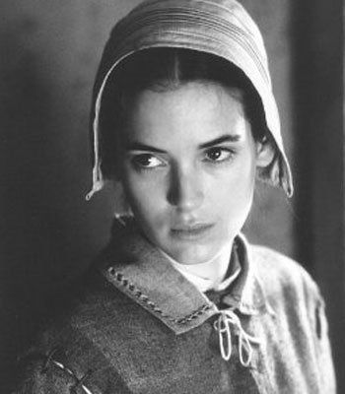
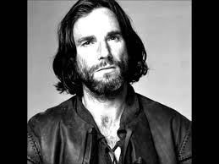
Dramatic terminology cntd
Protagonist: main character; usually goes through a change
John Proctor
Antagonist: character or force in conflict with the protagonist
Abigail Williams

Slide 8
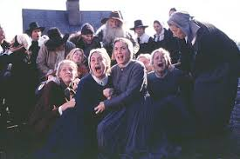
Dramatic terminology cntd.
Internal conflict: man vs. self; the character struggles with something within himself
90% of the time this is going to be guilt
External conflict: man vs. man; man vs. nature; man vs. society

Slide 9
Dramatic terminology cntd
Dramatic irony
When the audience or readers know more than the characters
Think: horror movies when the audience knows if the character runs opens the door the monster is on the other side waiting to cause harm.
Symbol
Anything that stands for or represents something more than what is actually seen
Think: a dove is a symbol for peace; the color white as a symbolism for purity.
Allegory
A story with two levels of meaning- a figurative and a literal
Characters, setting, events represent something else
Think: The Tortoise and The Hare (Tortoise/Hare = real life people; The race = real life)
Think: The Lorax (the ravages technology has on society)

Slide 10
Arthur miller and allegory
Arthur Miller saw the similarities between McCarthyism and the Salem Witch Trials and chose to express that in his play, The Crucible
McCarthyism started with Senator Joseph McCarthy when he made a list of people (politicians, celebrities, artists) who were supposedly communists.
This turned into people accusing other people to get out of going to jail based on no evidence whatsoever (Just like the Crucible!)

Slide 11
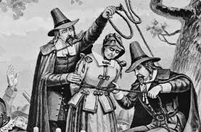
5 Ws of the salem witch trials
Who: The Puritans
What: Witch Hunts
When: 1690s
Where: Salem, Mass
Why: fear (people who were accused could get out of getting into trouble if they accused someone else; or if you accused someone no one would think to accuse you)

Slide 12
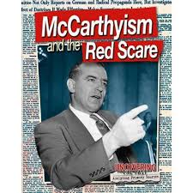
5 ws of mccarthyism
Who: Joseph McCarthy and eventually many other Americans
What: Communist hunts
When: 1950s
Where: America
Why: fear (people who were accused could get out of getting into trouble if they accused someone else; or if you accused someone no one would think to accuse you)

Slide 13
The power of persuasion & mccarthyism
Senator Joseph McCarthy of Wisconsin claimed to have a list of over 200 names of gov’t employees that were members of the communist party
Senator Joseph McCarthy of Wisconsin waged a campaign to expose Communist spies in the U.S. gov’t
Started with gov’t officials, went to Hollywood, athletes, playwrights (Arthur Miller)
McCarthy played on the nation’s fears to build his own political power

Slide 14
Historical context of Salem witch trials
The Puritans were VERY religious people and were serious about dealing with anything in the supernatural world.
If you were accused of witchcraft you had a few options
1. You could confess, and the congregation and God for forgiveness and you would be let go
2. You could deny it and hang
3. You could say, “Well, I’m not a witch, but I know who is!”
By blaming someone else you would be off the hook

Slide 15
Historical context of salem witch trials… con’t.
The minister’s daughter and other girls became “afflicted”
It was discovered that these girls along with others were dabbling with witchcraft with their slave, Tituba
To avoid getting into trouble for this very serious crime they immediately told everyone that Tituba made them do it.
They began making up other stories and saying other women were seen with the devil.
Everyone believed them, so they kept using their power to have people killed out of fear for their own lives.

Slide 16
Similarities between the salem witch trials & mccarthyism
Both were triggered by fear
Both involved hysteria
People being accused and the accusers got WAY out of control
Innocent people were put in jail and/or killed
Some showed courageous integrity
Some people continually denied the accusations in order to tell the truth even though they knew it would end up getting them killed

Slide 17
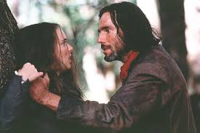
Crucible’s main characters
Abigail Williams: Reverend Parris’ niece; she is kind of the girls’ leader; she is the first to accuse anyone of being a witch; she does EVERYTHING just to be with a man (former lover, John Proctor)
John Proctor: married to Elizabeth Proctor; had an affair with Abigail; knows the girls are being ridiculous and tries to have them exposed
Reverend Parris: cares more about his reputation than anything else; he is the leader of the church and therefore, the leader of the government

Slide 18
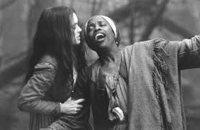
Crucible main characters
Tituba: Slave to the Reverend Paris; agrees to perform voodoo for Abigail only to blamed for the whole thing later
Reverend John Hale: brought in from another county; he is supposed to be an expert on all things witchcraft; he eventually realizes the girls are making everything up
Elizabeth proctor: John’s wife; fired Abigail from working in her home after discovering that she was having an affair with John; she is condemned
Betty Parris: Reverend Parris’ daughter; one of the “afflicted”

Slide 19
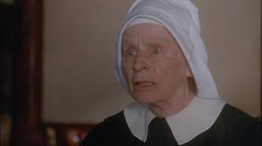
Crucible main characters
Rebecca Nurse: elderly woman in Salem who is respected by all; she is accused
Francis Nurse: A MAN! Husband to Rebecca; enemy to Thomas Putnam
Thomas Putnam: enemy to Francis Nurse; uses the witch trials to gain power and land
Ann Putnam: had 8 babies, 7 died and so they are left with only Ruth. Ann is convinced that her babies were killed by supernatural means
Ruth Putnam: one of the “afflicted”

Slide 20
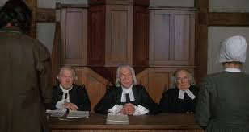
Crucible main characters
Giles Corey: has a tendency to file lawsuits against people; accidentally gets his own wife accused of witchcraft
Judge Danforth: deputy governor; resides over the trials
Mary Warren: one of the girls; tries to confess but gets sucked back in
Ezekial Cheever, Herrick, and Judge Hathorne: all members of the court

