Slide 1
American Literature Vocabulary
Unit 14
Fall 2018

Slide 2
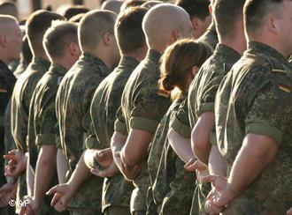
amenable (adj)
willing to follow advice or authority
submissive
compliant
agreeable
---------------------
resistant

Slide 3
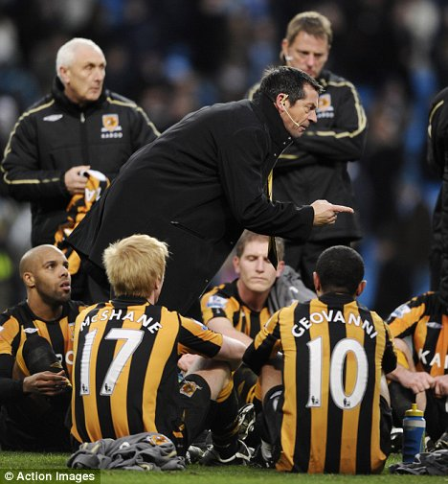
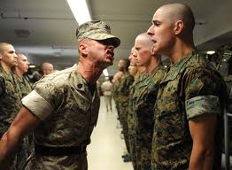
berate (v)
to scold sharply
chide
rebuke
reprimand
reprove
-------------------------
praise

Slide 4
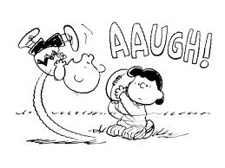
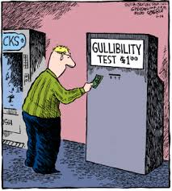
credulous (adj)
too ready to believe
easily deceived
gullible
trusting
--------------------
skeptical

Slide 5
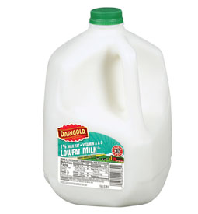
criterion (n)
a rule or test
a standard for judgment or evaluation
gauge

Slide 6
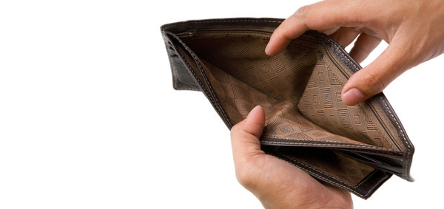
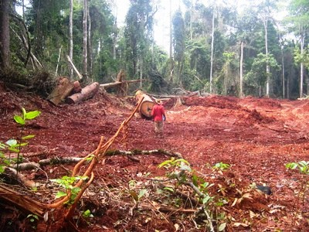
deplete (v)
to use up as a result of spending or consumption
to diminish greatly
to drain
to empty
-------------------------
to replenish

Slide 7
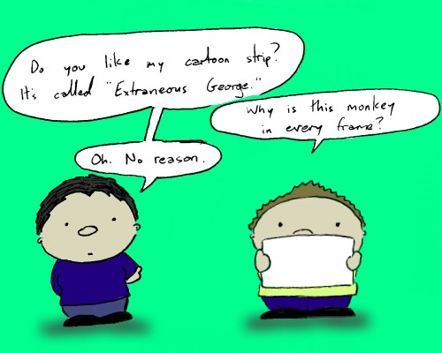
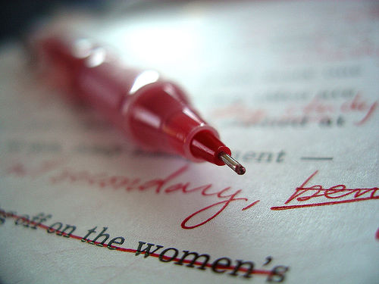
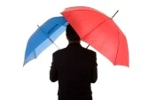
extraneous (adj)
coming from the outside
present but not essential
irrelevant
incidental
-----------------------
relevant

Slide 8
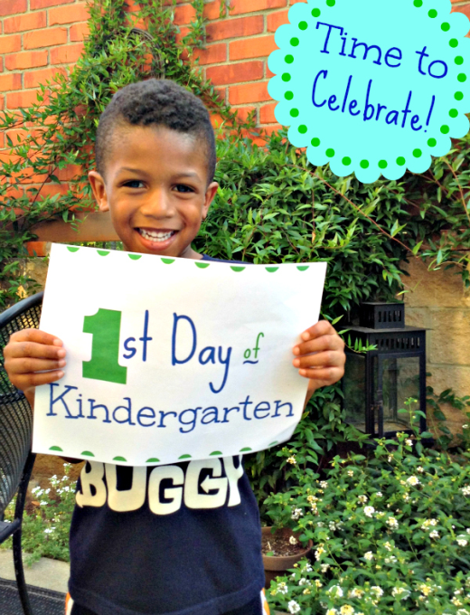
inception (n)
the beginning or start
the earliest stage of some process or institution
inauguration
outset
----------------------------
conclusion

Slide 9
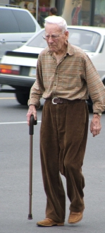
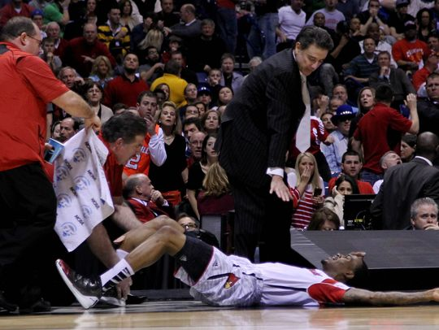
infirmity (n)
a weakness or ailment
an affliction
a malady
a defect

Slide 10
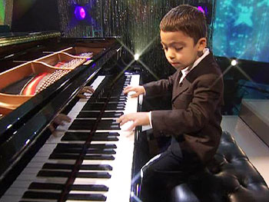
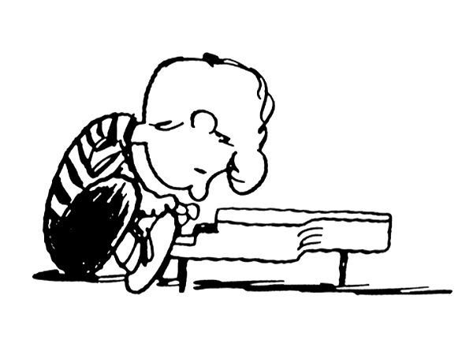
Precocious (adj.)
showing unusually early development (especially in talents and mental capacity)
gifted
advanced
---------------------------
backward or slow

Slide 11
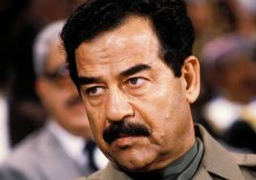
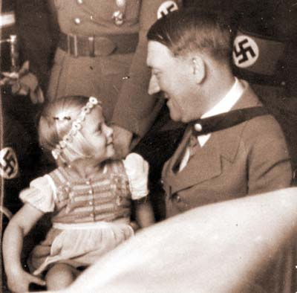
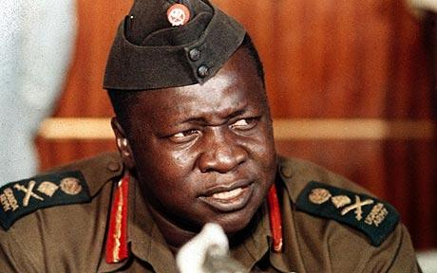
Sadistic (adj.)
delighting in cruelty
excessively cruel
brutal
vicious
inhuman
---------------------
humane
merciful

