Slide 1
American Literature
Unit 11

Slide 2
censurable
deserving of blame or correction
reprehensible
Antonyms:
commendable
meritorious

Slide 3
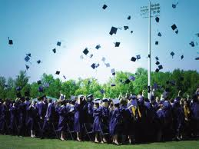
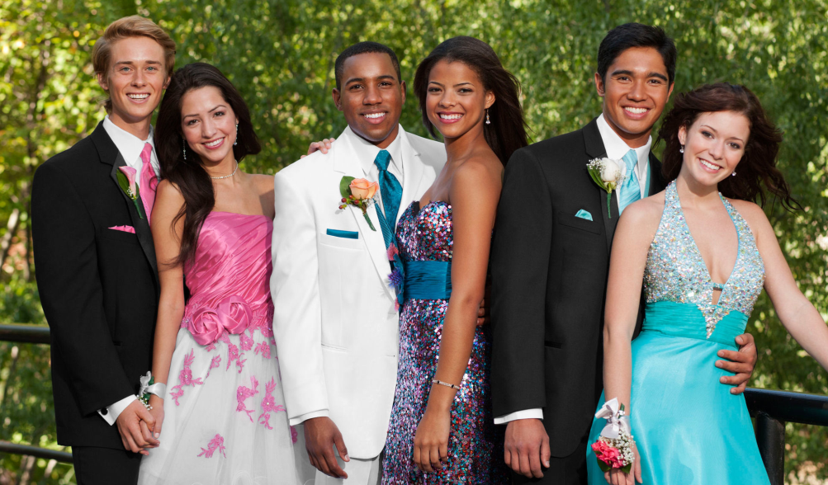
contingent
likely, but not certain to happen
happening by chance
conditional
Antonyms:
certain
independent of

Slide 4
corroborate
to confirm
to verify
Antonyms:
contradict
discredit

Slide 5
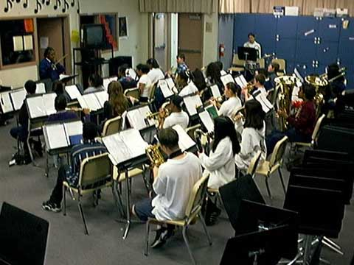
denizen
an inhabitant
a resident
a dweller
Antonyms:
alien
stranger
foreigner

Slide 6
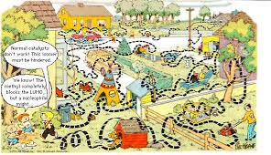
discursive
rambling
wandering
nomadic
Antonyms:
short and to the point

Slide 7
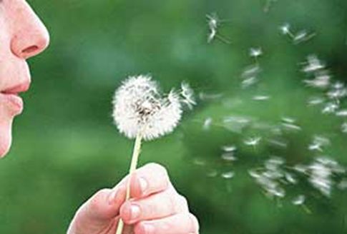
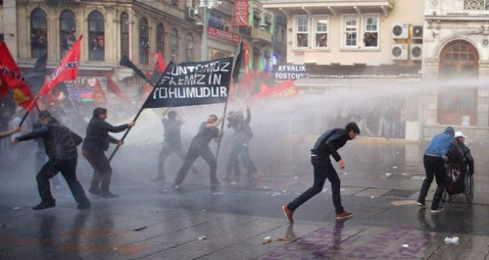
disseminate
to scatter or spread widely
disperse
broadcast
Antonyms:
bring together
concentrate

Slide 8
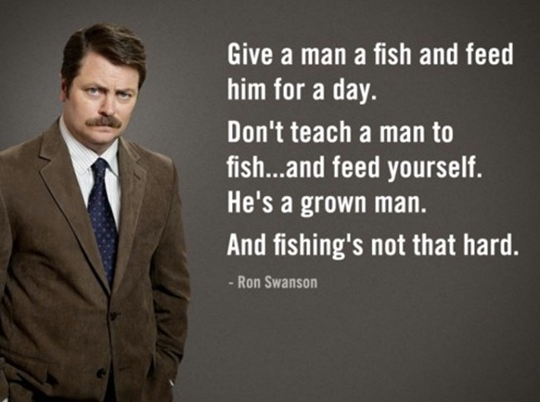
gauche
awkward
lacking in social graces
tactless
clumsy
inept
Antonyms:
tactful
diplomatic

Slide 9
inculcate
to impress on the mind by repetition
to ingrain
Antonyms:
efface
root out

Slide 10
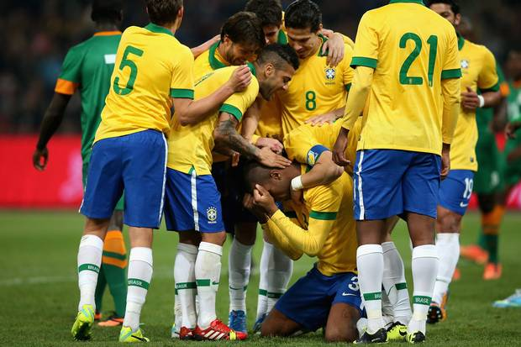
palpable
capable of being touched or felt
easily seen, heard, or recognized
tangible
Antonyms:
intangible

Slide 11
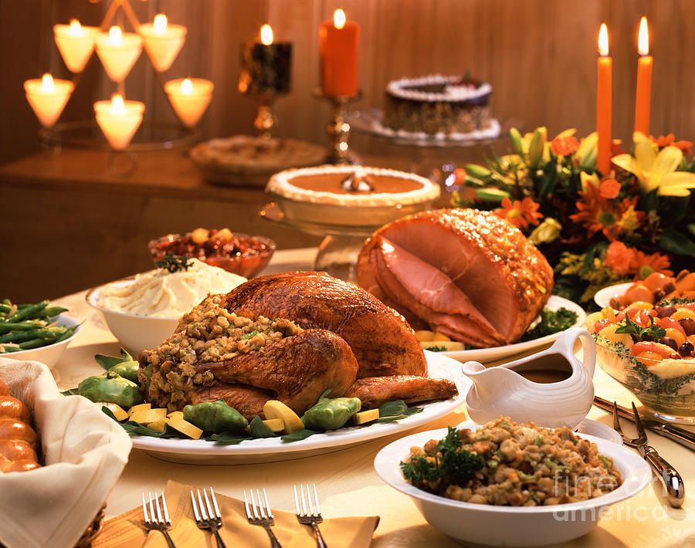
satiate
to satisfy completely (v.)
gorge
full, satisfied (adj.)
Antonyms:
deprive entirely of

