Slide 1
American Lit SAT Vocabulary
Unit 12
Fall 2017

Slide 2
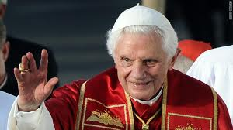
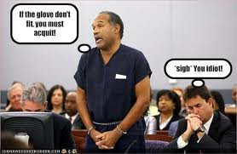
Absolve - verb
to clear from blame, responsibility, or guilt
acquit
excuse
pardon
-----------------------
convict
condemn

Slide 3
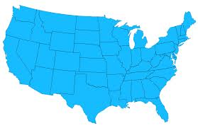
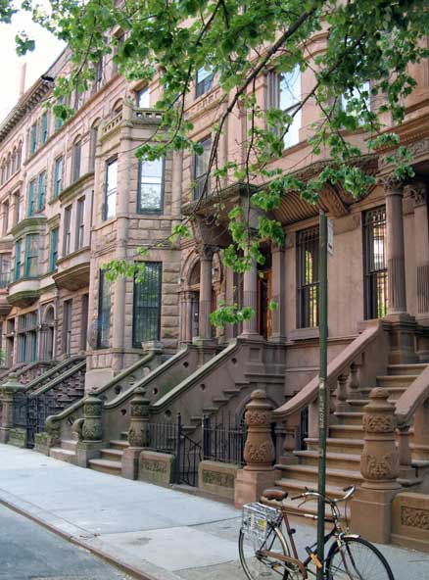
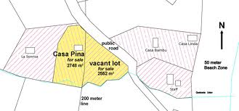
Contiguous- adjective
side by side, touching
near
next door to
---------------------
detached

Slide 4
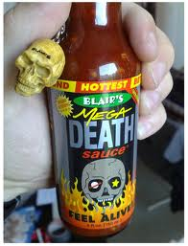
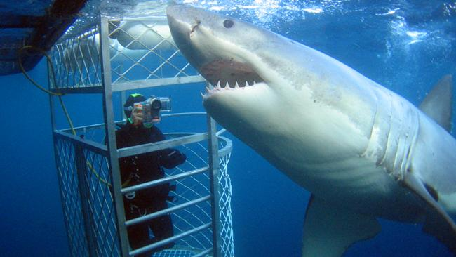
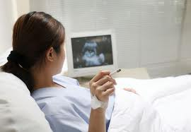
Deleterious- adjective
harmful
injurious
destructive
damaging
---------------------
beneficial

Slide 5
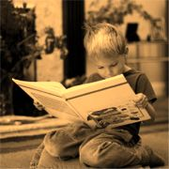
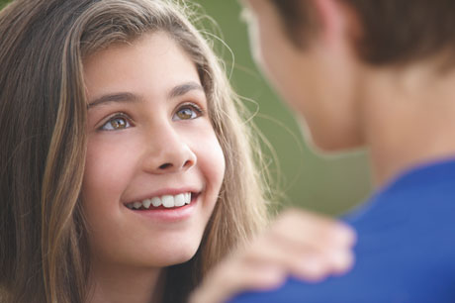
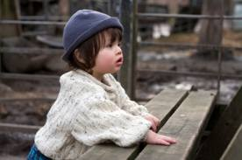
Enthrall- verb
to captivate, charm
to hold spellbound
to enslave, to imprison
attract
-------------------------
repel

Slide 6
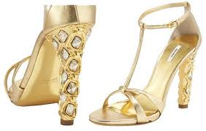
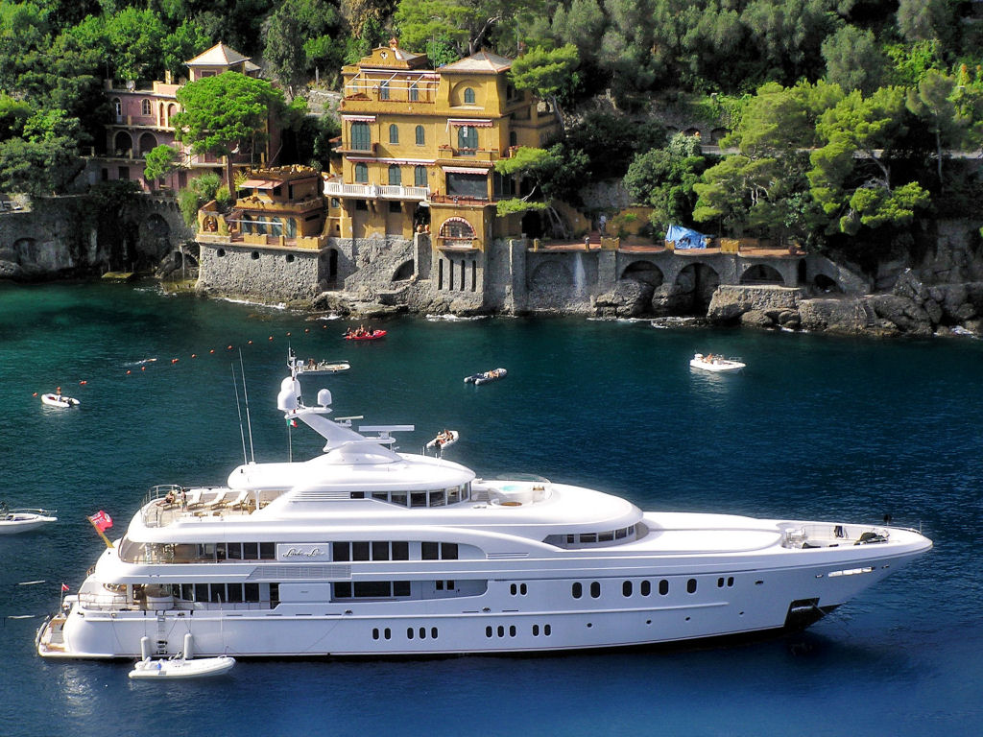
Ostentatious-adjective
marked by conspicuous or pretentious display
showy
flashy
overdone
flamboyant
---------------------------
modest, plain

Slide 7
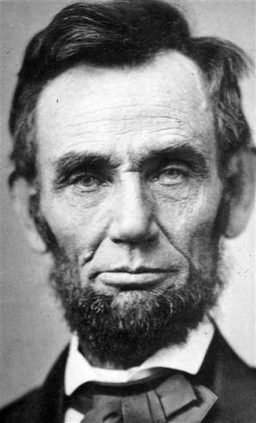
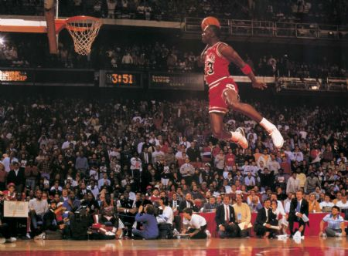
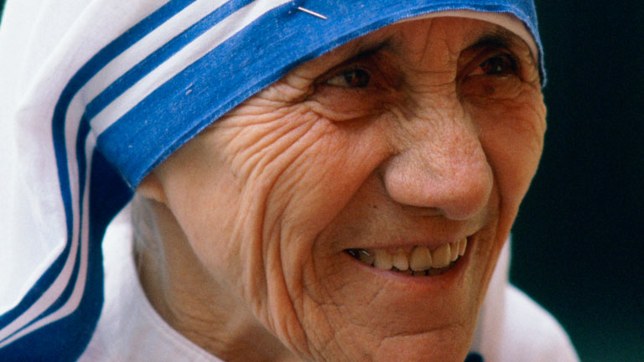
Paragon-noun
a model of excellence or perfection
ideal
paradigm
model
good example

Slide 8
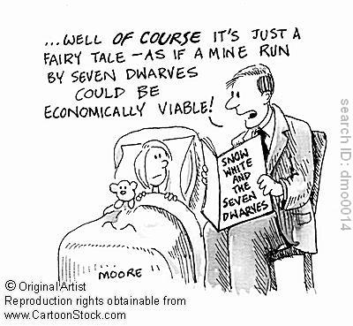
Prosaic-adjective
dull, lacking in distinction and originality
matter-of-fact
literal
---------------------
inspired, poetic

Slide 9
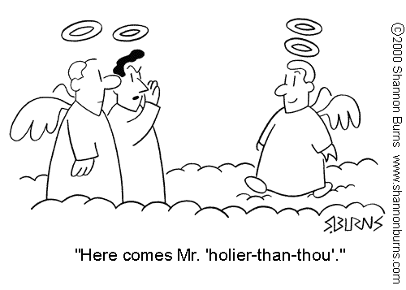
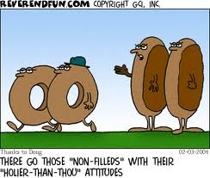
Sanctimonious-adjective
making a show of virtue or righteousness
hypocritically moralistic or pious
holier-than-thou
------------------------
sincere, humble

Slide 10
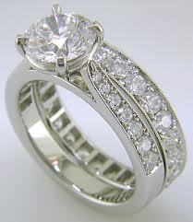
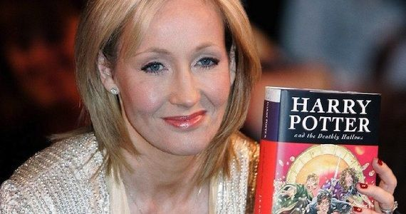
Scintillating-adjective
sparkling, twinkling
exceptionally brilliant
stimulating
glittering
----------------------
dull

Slide 11
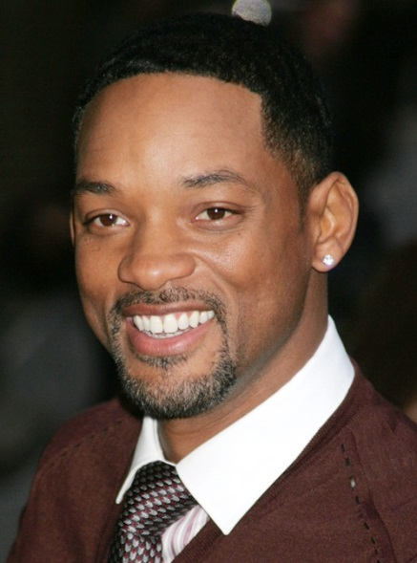
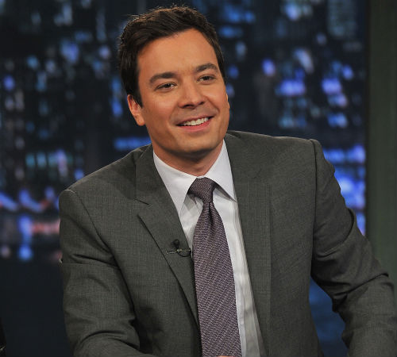
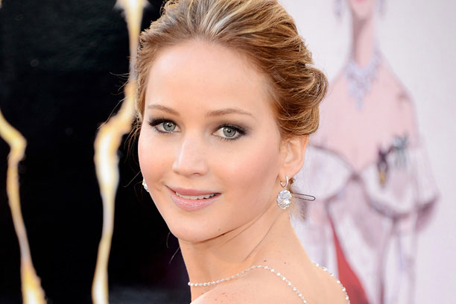
Winsome-adjective
charming
attractive
pleasing
delightful
------------------
repulsive

