Slide 1
SAT Vocabulary
Unit 13 Terms

Slide 2
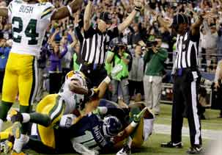
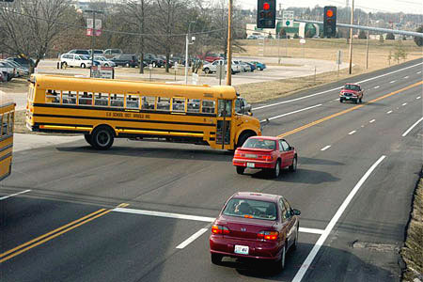
blatant (adj)
noisy in a coarse, offensive way
obvious or conspicuous, especially in an unfavorable way
---------------------------------
inconsequential

Slide 3
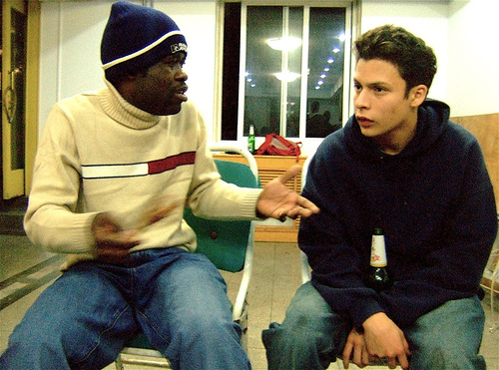
broach(v/n)
to bring up or begin to talk about (a subject)
to announce
to introduce

Slide 4
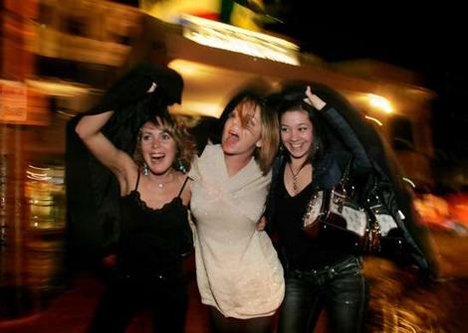
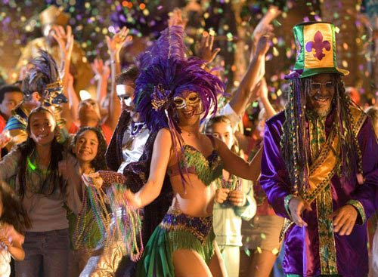
carousal (n)
noisy revelry or merrymaking (often with a suggestion of heavy drinking)
binge
jamboree

Slide 5
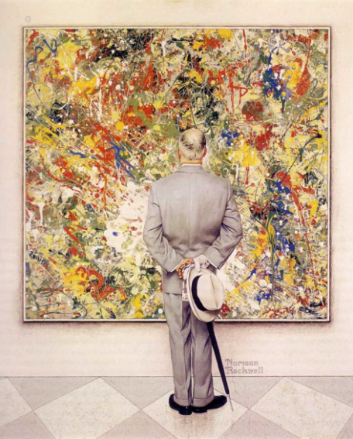
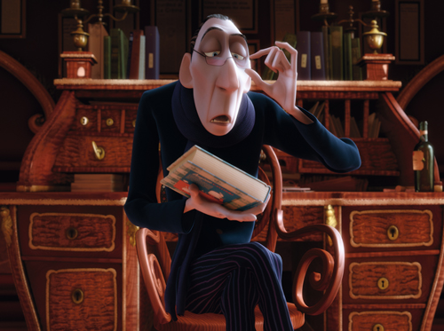
connoisseur (n)
an expert
one who is well qualified to pass critical judgments
especially in one of the fine arts
savant

Slide 6
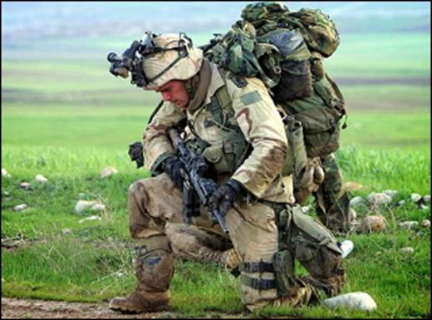
encumber (v)
to weigh down or burden (with difficulties, cares, debt)
block up
hinder
------------------------------
relieve

Slide 7
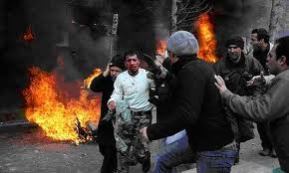
foment (v)
to promote trouble or rebellion
instigate
incite
to warm
----------------------
quell

Slide 8
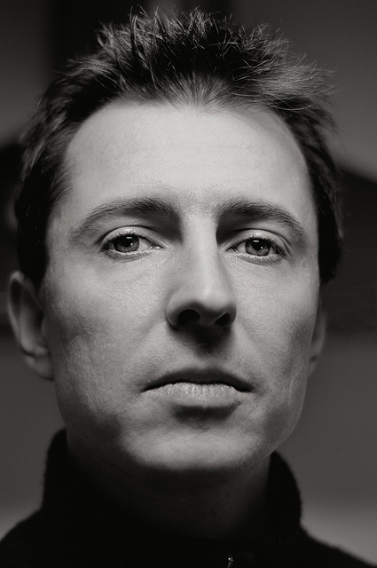
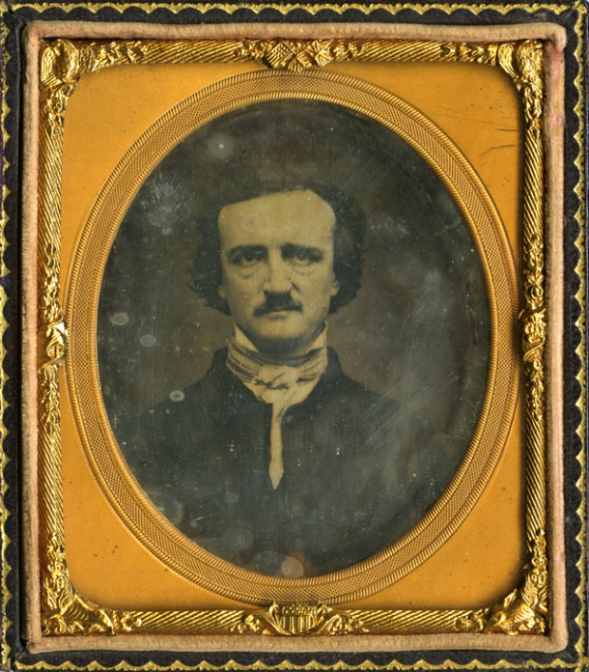
impassive (adj)
showing no feeling or emotion
inanimate
stoical
insensible
------------------------
emotional

Slide 9
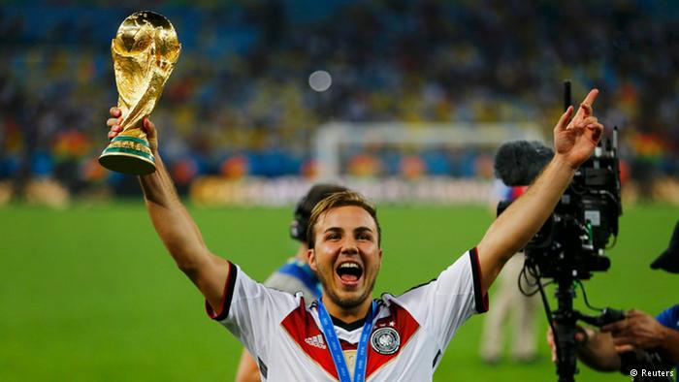
incontrovertible (adj)
unquestionable
beyond dispute
incontestable
indisputable
---------------------
debatable

Slide 10
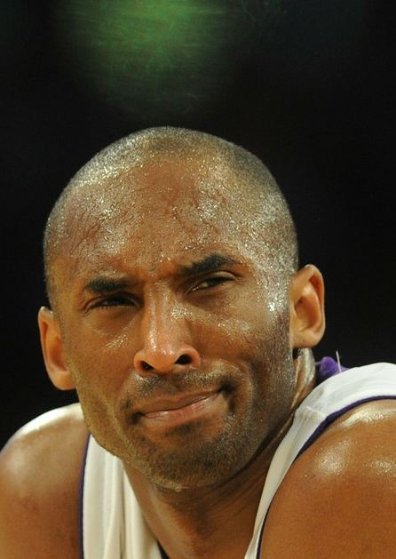
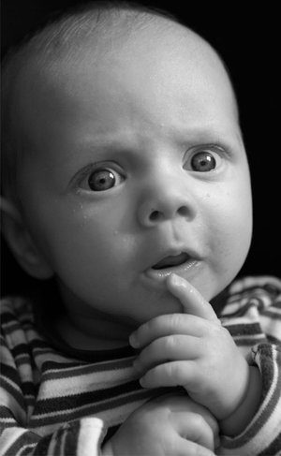
nonplussed (adj)
puzzled
not knowing what to do
perplexed
stumped
flabbergasted
--------------------------
confident

Slide 11
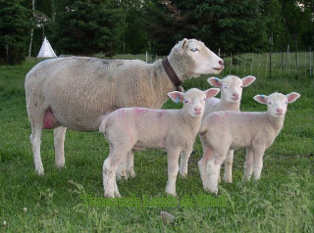
prolific (adj)
abundantly productive
profuse
fruitful
--------------------
unproductive

